Slide 1
Using Google Trends to explore temporal and geographical patterns in search query data
Charlotte Woolley
University of Edinburgh
15th of November 2017

Slide 2
What is Google Trends?
Online facility of Google Inc.
Freely available and publically accessible
Provides pre-processed search query data from January the 1st 2004 until present day
Regularly updated trending themes/topics.
Google Trends website (https://trends.google.co.uk/trends/)

Slide 3
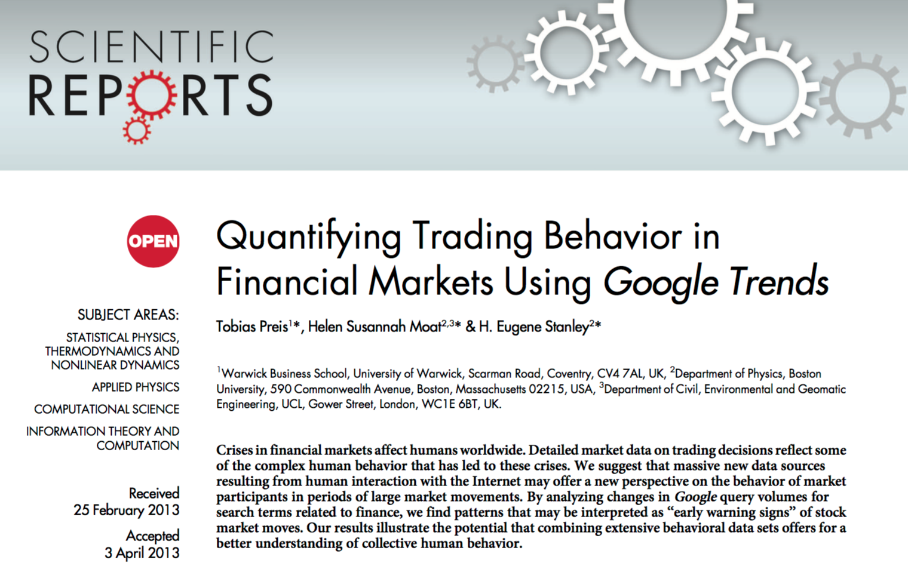
Why is search query data important?
Over 50% of the world's population has internet access
88% in the UK (Office for National Statistics, 2016)
Google Trends has been used for a range of research, including:
General health
Infectious disease
Mental health
Veterinary health
Financial
Marketing
Political
Preis et al., 2013

Slide 4
What exactly is Google Trends data?
Normalised - an ‘index’ of the proportion of queries within a particular region at a particular time divided by the total number of queries at that region and time, where the max number of queries is scaled at 100
Anonymised
Aggregated based on various time frames
Cached daily
Rounded to the nearest integer
Categorised
De-duplicated
De-symbolised

Slide 5
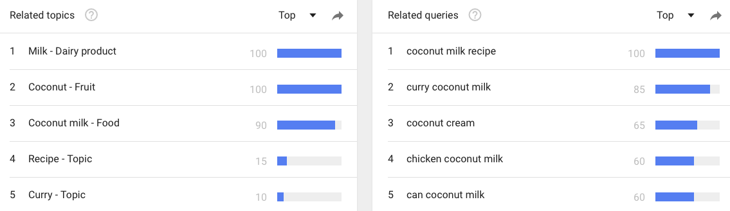
Top and rising related terms and topics
Related queries are matches within your query in the same language
Related topics have a similar concept and not necessarily in the same language
Top refers to the most frequent
Rising refers to the most growth in volume

Slide 6
Understanding biases in Google Trends data
The effect of the media
Unanticipated changes in search algorithm dynamics over time
(linguistics, culture, technological changes etc.)
Shifts in the population of internet users
Search query selection (ambiguity of search terms, spelling errors)
Big data hubris
Interference from Google suggestions
Changes in Google data collection and geographical assignment
Gaps in data supplied by Google Trends
Functionality of the gtrendsR package

Slide 7
Using the gtrendsR package - Investigating searches for 'hay fever' in the UK since Google Trends began
'gtrends' function
Same arguments as Google Trends website
Data easily exported into R
Package allows you to explore, analyse and plot the data

Slide 8
Using the gtrendsR package - Investigating searches for 'hay fever' in the UK since Google Trends began

Slide 9
Using the gtrendsR package - Tutorial
Github: https://github.com/CharlotteWoolley/Google_Trends_gtrendsR_Tutorial
R Markdown tutorial
Raw code for the tutorial
Leave me questions!
Email – s1576473@sms.ed.ac.uk
Questions?

Slide 10
References
Carrière-Swallow, Y., Labbé, F. (2011). Nowcasting with Google Trends in an Emerging Market. Journal of forecasting, 32, 289-298.
Dimitrov, B. D. (2016). Nowcasting incidence of emergent zika virus infection and its outbreaks using Google Trends data: Examples from Brazil and Colombia. International Journal of Infectious Diseases, 53, 98.
Eysenbach, G. (2002). Infodemiology: the epidemiology of (mis)information. The American Journal of Medicine, 113(9), 763-765
Google. (2017). Google Trends Help. Retrieved January 10, 2017, from https://support.google.com/trends/?hl=en#topic=6248052
Granka, L. (2013). Using Online Search Traffic to Predict US Presidential Elections. PS: Political Science & Politics, 46(2), 271-279
Massicotte, P., Eddelbuettel, D. (2016). Package ‘gtrendsR’. Retrieved 30 March, 2017, from https://cran.rproject.org/web/packages/gtrendsR/gtrendsR.pdf
Milinovich, G. J., Avril, S. M., Clements, A. C., Brownstein, J. S., Tong, S., & Hu, W. (2014). Using internet search queries for infectious disease surveillance: screening diseases for suitability. BMC Infectious Diseases, 14, 690
Moccia, M., Palladino, R., Falco, A., Saccà, F., Lanzillo, R., & Brescia Morra, V. (2016). Google Trends: new evidence for seasonality of multiple sclerosis. Journal of Neurology, Neurosurgery, and Psychiatry, (1), jnnp-2016-313260.
Nuti, S. V., Wayda, B., Ranasinghe, I., Wang, S., Dreyer, R. P., Chen, S. I., & Murugiah, K. (2014). The use of google trends in health care research: A systematic review. PLoS ONE, 9(10).
Office for National Statistics. (2016). Internet users in the UK: 2016. Statistical Bulletin, 1–9. Retrieved 08 January, 2017, from https://www.ons.gov.uk/businessindustryandtrade/itandinternetindustry/bulletins/internetusers/2016
Preis, T., Moat, H. S., Stanley. H. E. (2013). Quantifying trading behavior in financial markets using Google Trends. Scientific Reports, 3, 1684
Stephens-Davidowitz, S., & Varian, H. (2015). A Hands-on Guide to Google Data. Google, Inc., 1–25. Retrieved January 10, 2017, from http://people.ischool.berkeley.edu/~hal/Papers/2015/primer.pdf
Yang, A. C., Huang, N. E., Peng, C. K., & Tsai, S. J. (2010). Do seasons have an influence on the incidence of depression? the use of an internet search engine query data as a proxy of human affect. PLoS ONE, 5(10), 1–7.
Yang, A. C., Tsai, S. J., Huang, N. E., & Peng, C. K. (2011). Association of Internet search trends with suicide death in Taipei City, Taiwan, 2004-2009. Journal of Affective Disorders, 132(1–2), 179–184.

